Slide 1
301 Oct 17, Class 14
Reviewing research with factorial designs
Levav & Argo (2010)
  Factorial design example
Ovalle-Fresa, Uslu & Rothen (2021)
  More background for Experiment 2

Slide 2
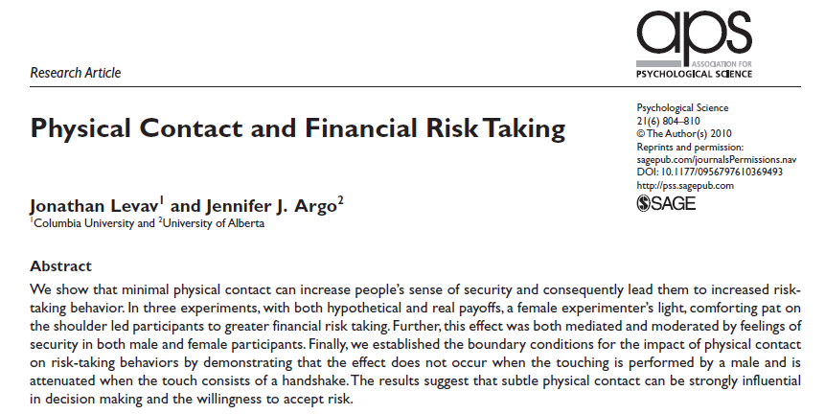
Levav & Argo (2010)

Slide 3
Assignment Question 1
Experiment 1 is a simple two group study.
The procedure for implementing the independent variable is described as “In the touch condition, the verbal instruction was accompanied by a light, open-palmed touch on the back of the shoulder blade, right below the deltoid; this touch lasted approximately 1 s. In the no-touch condition, the verbal instruction was unaccompanied by any form of touch. Following this manipulation, the experimenter — who was blind to the hypothesis—retreated to a cubicle on the other side of the room so as not to be visible to the participant.”
Why does this operational definition of “touch” need such an elaborate description?

Slide 4
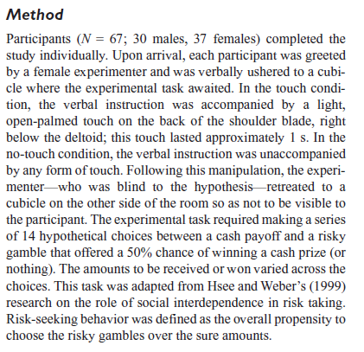
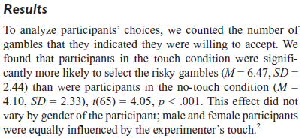
Design, Experiment 1

Slide 5
Assignment Questions 2-5
Experiment 2 uses a factorial design. How many factors are there and how many levels of each factor?
What is the dependent variable in Experiment 2?
List the hypotheses tested by this design.

Slide 6
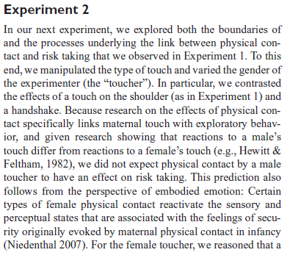
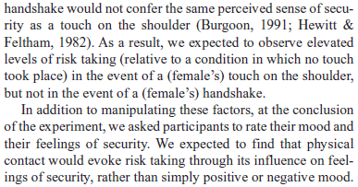

Slide 7
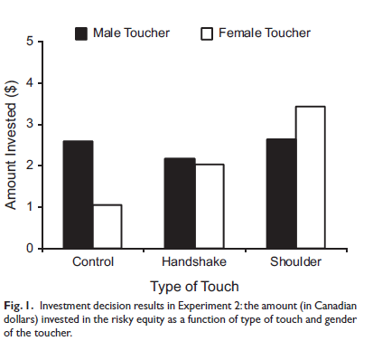
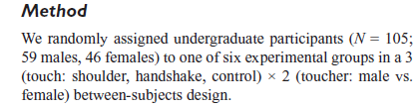
Experiment 2

Slide 8

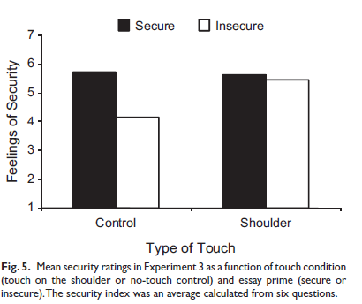
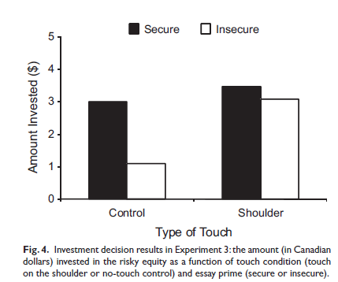
Experiment 3
Operational definition, Security:
We primed feelings of security or insecurity in a laboratory room by having participants write a brief essay about a time in their life when they “felt secure and supported” (secure-essay condition) or a time in their life when they “felt insecure and alone” (insecure-essay condition).

Slide 9
Describe the interaction shown in Figure 4 (Experiment 3)
What big picture conclusions do the authors draw from the 3 studies?

Slide 10
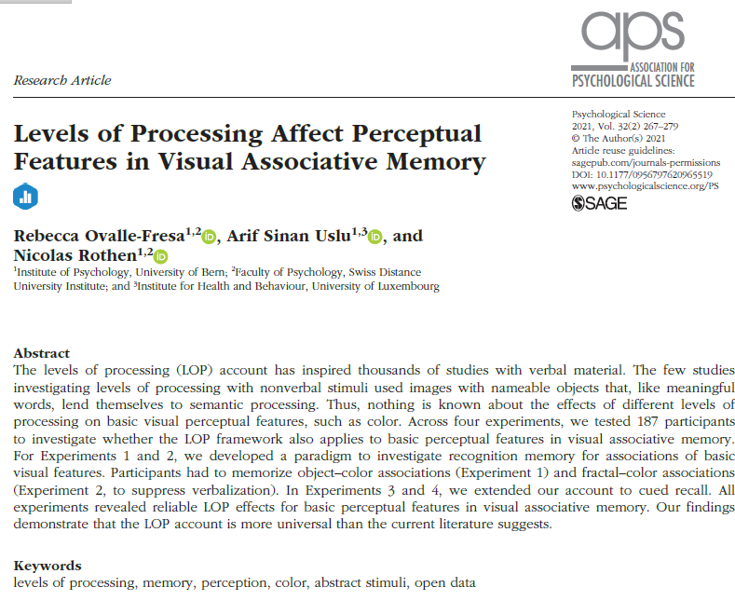

Slide 11
In Experiment 1, what operational definitions were used for the deep and shallow encoding conditions? (What were participants asked to do in the procedure?)

Slide 12
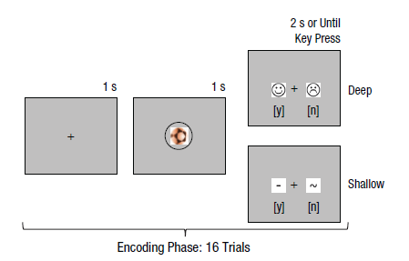
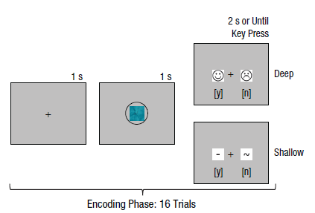
LOP with visual objects
Deep: yes/no pleasant
Shallow: yes/no contains straight line
Exp1: Instructed to try to memorize
object-color pairings
Exp2: Abstract images and color

Slide 13
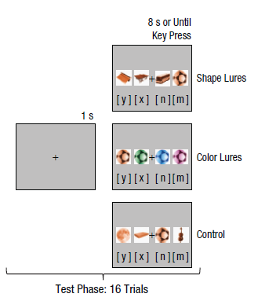
Recognition Memory
Four choices
Studied object and 3 “lures”
  Same color or
  Same shape
2x3 within-participant design
  Everybody does both kinds of study
  All three tests

Slide 14
Lure conditions
The lures in the recognition phase involved shapes, colors, or control objects. In the shape-lure condition, the four different shapes had an identical color.
Only one of the shapes had been presented in the specific color during encoding (target). The other three shapes (lures) had also been presented during encoding but in a different color. In the color-lure condition, the four shapes were identical but had different colors. All colors were part of the corresponding encoding phase, but three were associated with different shapes from those during encoding (lures), and one was associated with the same shape as during encoding (target).
In the control condition, different shapes had the same color, but only one shape had been part of the encoding phase (target); the remaining shapes were novel and had not been part of the encoding phase (lures). The novel objects were taken from Set B (see Table 1) and not otherwise used for a given participant.

Slide 15
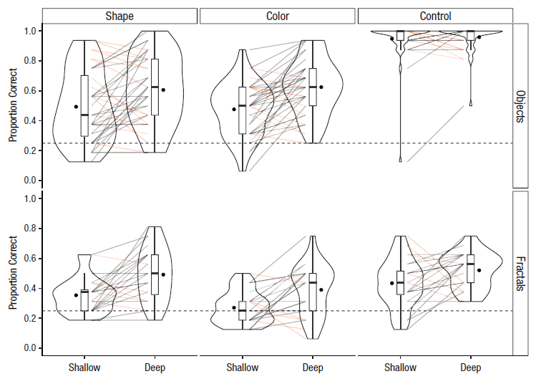
Experiment 1 Result
Violin plots
  Visualizes the distribution of data more than just SD/SE bars

Slide 16
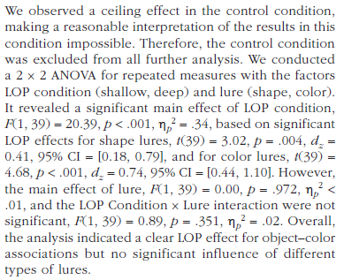
In the Results for Experiment 1, a 2x2 ANOVA is reported. Which of the three effects tested in this analysis were reliable and how was this interpreted?

Slide 17
In Experiment 2, what was changed about the stimuli compared to Experiment 1?
Why was the analysis of Experiment 2 done with a 2x3 ANOVA?

Slide 19
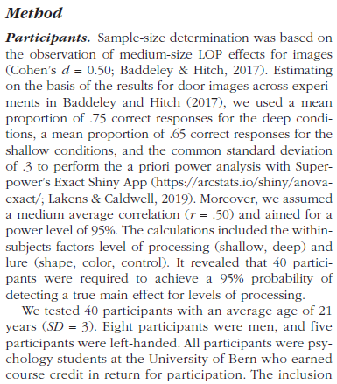
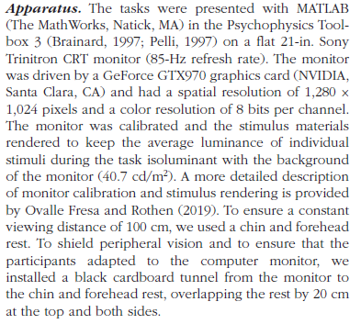
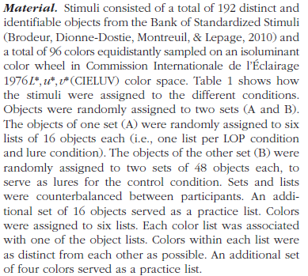
Detailed Methods Reporting

Slide 20

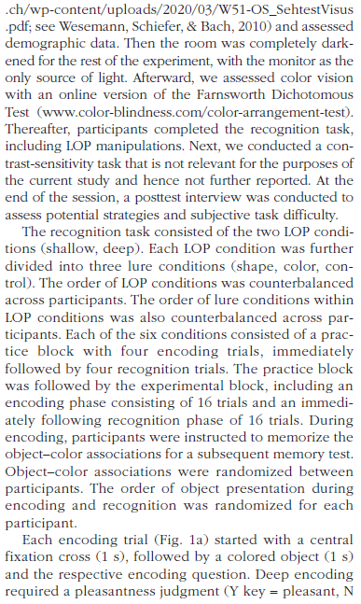
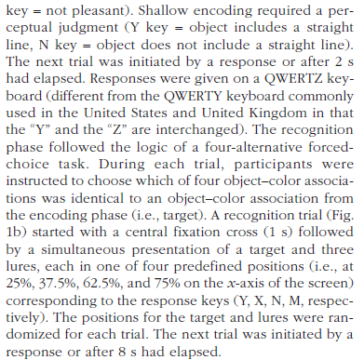
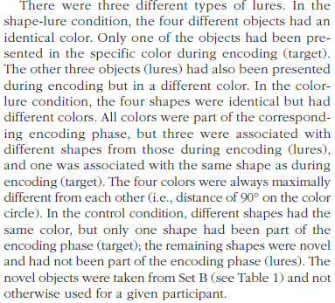

Slide 21
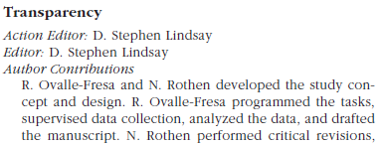
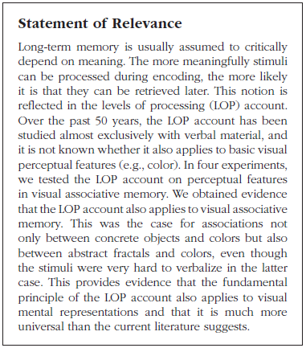

Rigor

Slide 22
For Monday 10/20
Practice 2x2 ANOVA with R: Operations Manual p. 37
  R script for analysis
  Practice (simulated) data analysis
  Copy/paste your analysis output text into the assignment
Chapter 11
  ANOVA examples to be reviewed in class
Recruit participants for Experiment 2 data collection

